Slide 1
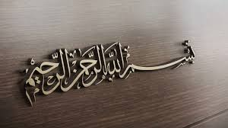
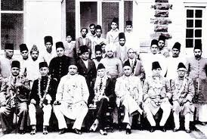
INDIAN NATIONAL CONGRESS AND ALL INDIA MUSLIM LEAGUE

Slide 2
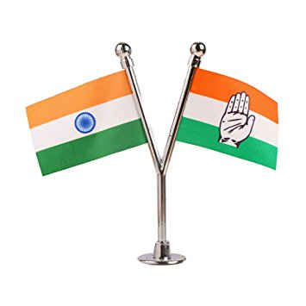
INDIAN NATIONAL CONGRESS:
FOUNDATION
Indian National Congress Was Found By A.O HUME, a retired British Officer in 1885.
PRESIDENT:
Barrister Womesh Chandra was chosen as the First President of Indian National Congress. He was Christian Hindu.

Slide 3
OBJECTIVES:
There are many objectives of foundation of Congress.Some Are As Follows:
To Fuse one Nation Whole of all the different elements that constitute the population of India.
To Consolidate the union between England and India,by securing the modifaction of such of its condition as may be unjust or injurious to the latter country.
To gradually regeperate along all lines,mental, moral, social and political of the nation thus evolved.
Well Wisher's Of England.
English Civil service examination to be held at a time in britten in india to promote this seats for indian people

Slide 4
MUSLIM AND CONGRESS:
* In First Meeting of Congress:
"Of the seventy-two delegates attending the first
session of the Congress only two were Muslim's."
1.Rehmatullah Sayani
2.Abdullah Dharamshi
* 2nd Meeting was held in kolkata.
* 3rd Meeting was held in 1887 held for to assure muslim they are non-communilism.they insisted Badruddin Tayyab Ji to president this meeting .Badruddin Tayyab Ji re-invited Sir Syed Ahmed Khan to organize this meeting ,

Slide 5
MUSLIM AND CONGRESS:
but he refused clearly by saying:
"Reset! I am not able to understand to why congress is
created .It is to assume that all nation's in india unite
this purpose , I think with sorrow that congress is not
in Favour of muslims.Congress is Against Muslim's.“
After sir syed above statement many muslim's left congress. Congress can't get Fame in muslim's.
* When Congress got power they become cruel to muslim's.

Slide 6
CONGRESS OPERATION AGAINST MUSLIM'S:
Congress started openly Hatred against Muslim by following Ways:
1.Banned on cow slaughtering.
2.Preffering Hindu festivals than Muslim's.
3.Interferrance in performing of Islamic duties.
4.National Anthem.
5.Politics Of flag.
6.Worshipp Of Gandhi.
7.Government Jobs.
8.Muslim's are Maleeh(Dirty).
9.Warda Educational Scheme.(To giving practical Shape to ideas of Gandhi.)
*According to Gandhi:
"Religion Spread Hatered."
*They Passed a bill to cancel religion from syllabus.
_____________________________

Slide 7
"ALL INDIA MUSLIM LEAGUE":
FORMATION:
* 1st MEETING SESSION:
* On 30th December 1906, the annual meeting of Muhammadan Educational Conference was held at Dhaka under the chairmanship of Nawab Waqar-ul-Mulk .
* Almost 3,000 delegates attended the session .
* Nawab Salim Ullah Khan presented a proposal for establish a political party in interest of Muslims; All India Muslim league.
* HeadQuarters Was established in Lacknow.
* PRESIDENT:
*Sir Agha Khan was elected as First President.

Slide 8
"ALL INDIA MUSLIM LEAGUE":
* SECRETERY:
* The first Secreteriat was Nawab Waqar-ul-Mulk and Nawab Mohsin-ul-Mulk.
* CONSTITUTION OF LEAGUE:
Maulana Muhammad Ali Jouhar wrote the Constitution of League , known as "Green Book".
* BRANCHES:
Branches were also setup in other provinces .Syed Ameer Ali established a branch in london in 1908,supporting same objective.
* MEMBERSHIP:
The initial Membership was 400 with member hailing proportionality from all provinces.

Slide 9
ALL INDIA MUSLIM LEAGUE
* 2nd MEETING SESSION:
Second Session of meeting was held in karachi in 1907.
* 3rd MEETING SESSION:
3rd Meeting was held in 1908 at Aligarh.In this meeting Sir Agha Khan elected as First President and Major Hassan Ali Bilgrami elected as secreteriat of All India Muslim League.

Slide 10

OBJECTIVES:
* To Protect Political and Other rights of Muslim's.
* To make assure to other communities that Muslim are not against their interest.
* Promoting Sentiments of Loyality and Removing Mis-understandings.
* Against Hatred Ideology.

Slide 11
ACHIEVEMENTS OF MUSLIM LEAGUE
(1) .PRESENTATION OF MUSLIM'S IN SUB-CONTINENT:
*AT SHIMLA CONFERENCE:
Organize by - Indian Muslim Leaders (met with Governer General and Viceroy Lord Minto in Simla on 1st Oct 1906).
Aim - To win sympathies of Raj on their side.
(2).ANSWER TO THE CONGRESS PROPOGANDA:
(3).APPROVEL OF SEPARATE ELECTORATE:
(4).FORMATION OF ALIGARH UNIVERSITY:
(5).LACKNOW PACT:
The main clauses of the Lucknow Pact were:

Slide 12
ACHIEVEMENTS OF MUSLIM LEAGUE
There shall be self-government in India.
Muslims should be given one-third representation in central government.
There should be separate electorates for all the communities until a community demanded for joint electorates.
System of weightage should be adopted.
The number of the members of Central Legislative Council should be increased to 150.
At the provincial level, four-fifth of the members of the Legislative Councils should be elected and one-fifth should be nominated.

Slide 13
ACHIEVEMENTS OF MUSLIM LEAGUE
The strength of Provincial legislative should not be less than 125 in the major provinces and from 50 to 75 in the minor provinces.
All members, except those nominated, were to be elected directly on the basis of adult franchise.
No bill concerning a community should be passed if the bill is opposed by three-fourth of the members
Term of the Legislative Council should be five years.
Members of Legislative Council should themselves elect their president.
Half of the members of Imperial Legislative Council should be Indians.
Indian Council must be abolished.
The salaries of the Secretary of State for Indian Affairs should be paid
Out of two Under Secretaries, one should be Indian
The Executive should be separated from the Judiciary.
______________________________________

